Slide 1
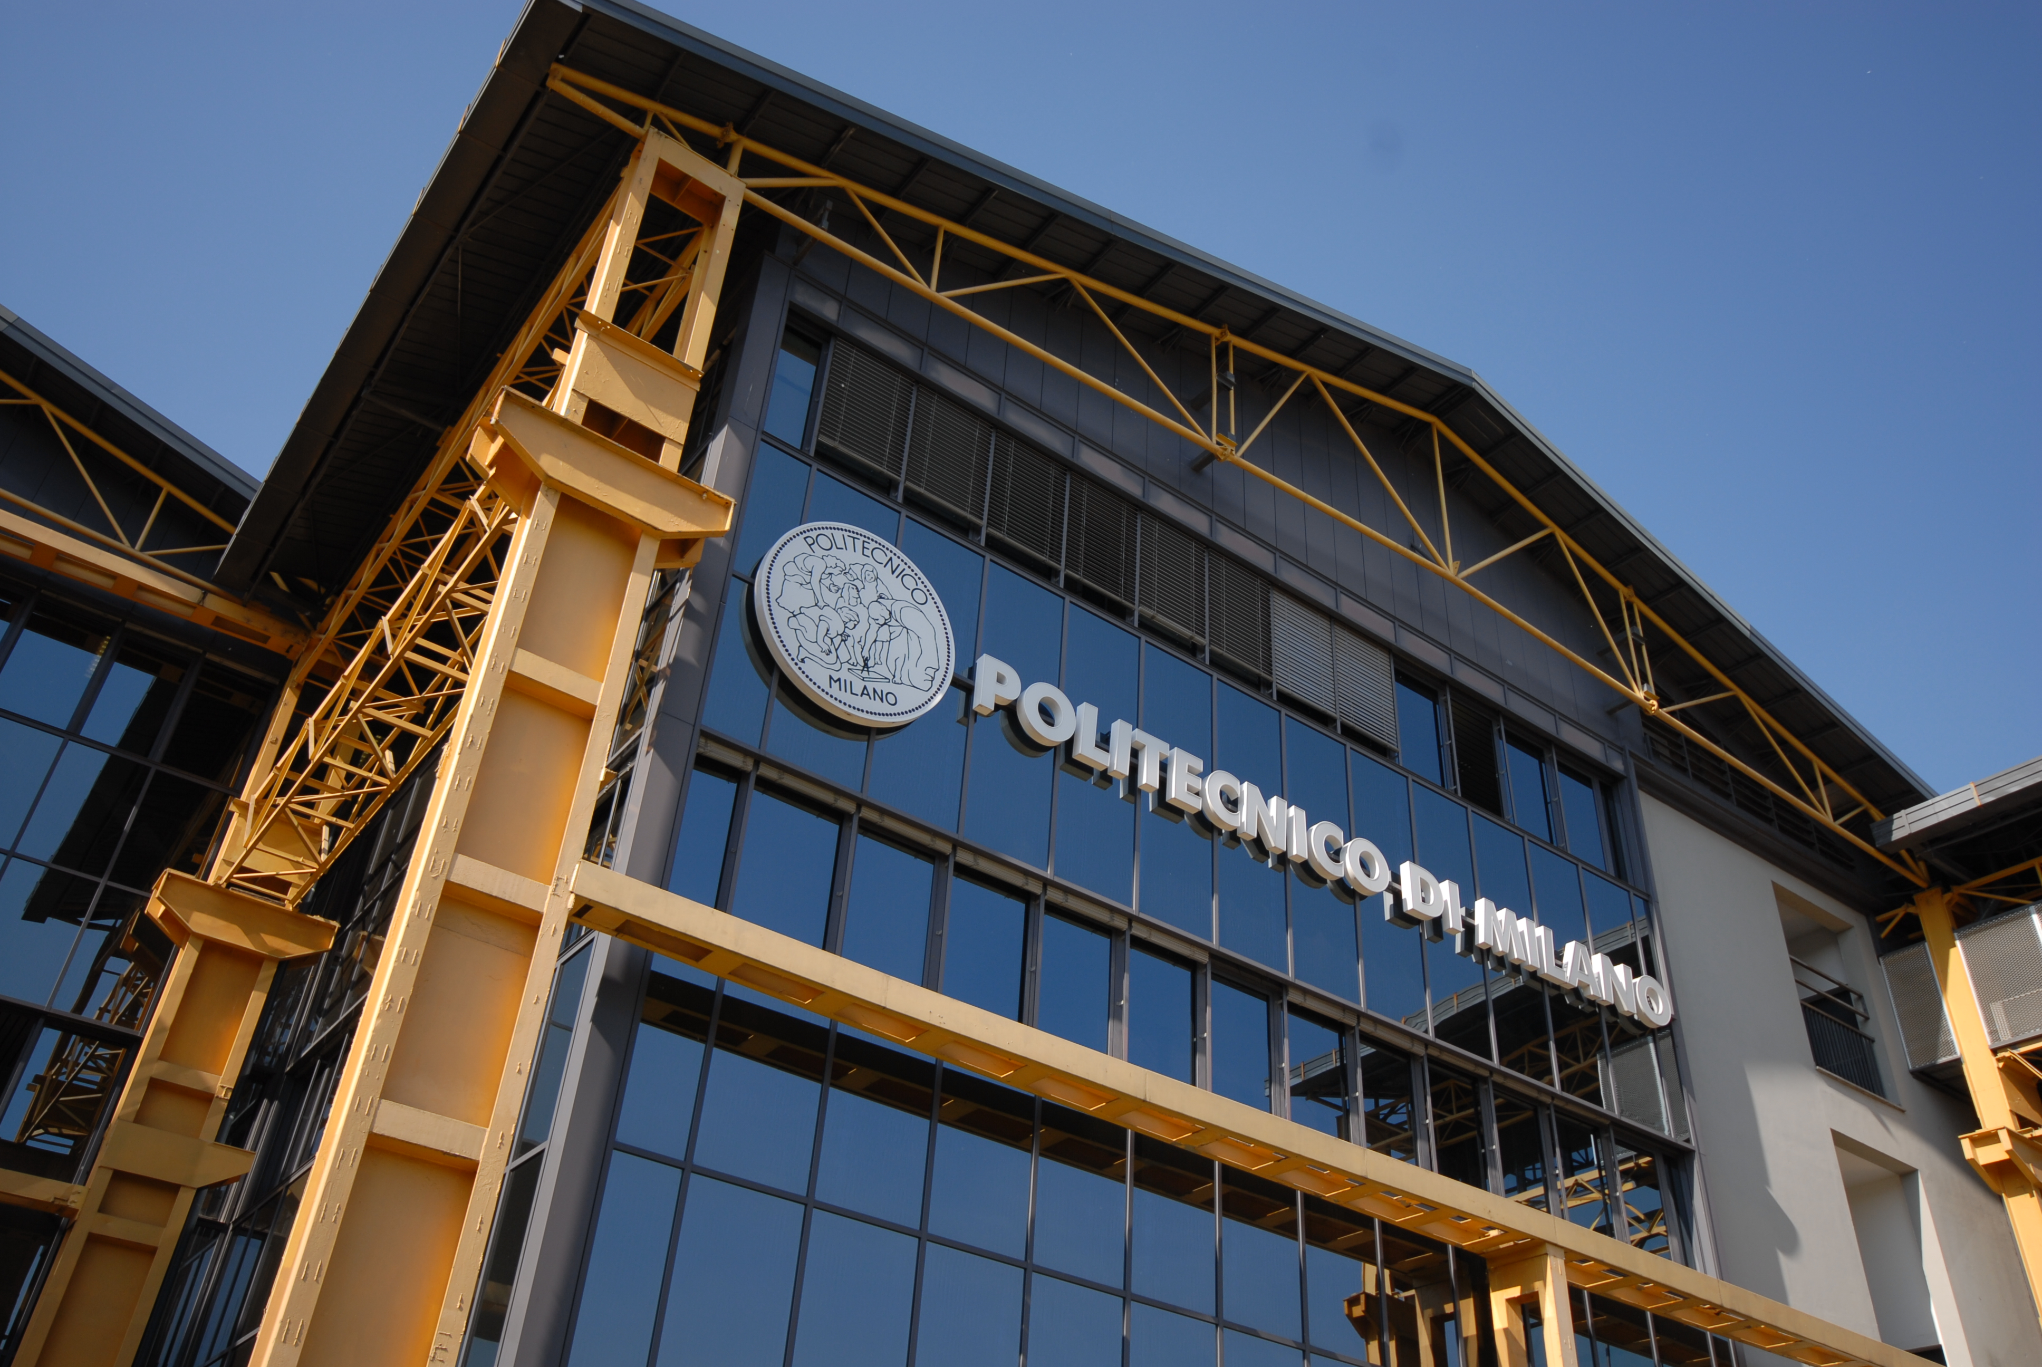

Titolo presentazione sottotitolo
Welcome Meeting for International Students
Management Engineering Programs
February 16, 2022
Milano, XX mese 20XX
Sergio Terzi, Anna Colella, Diletta Fiasca

Slide 2


Slide 3
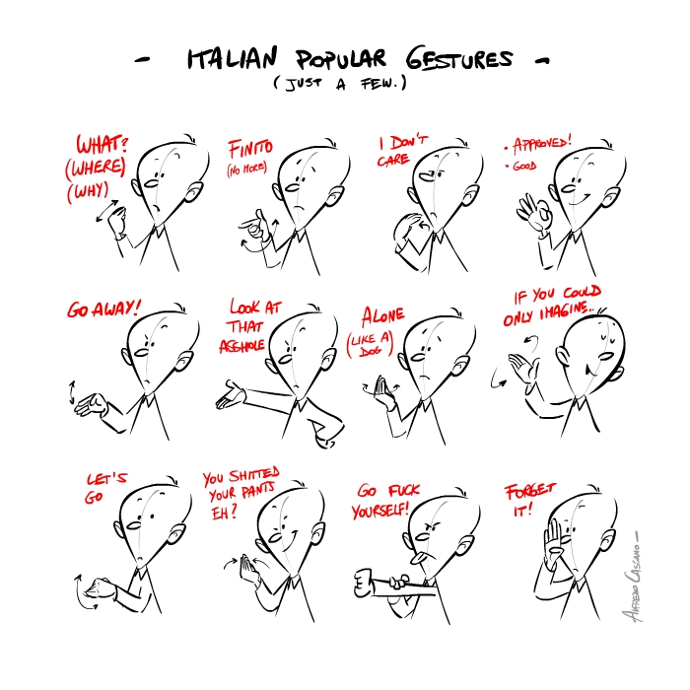

Slide 4
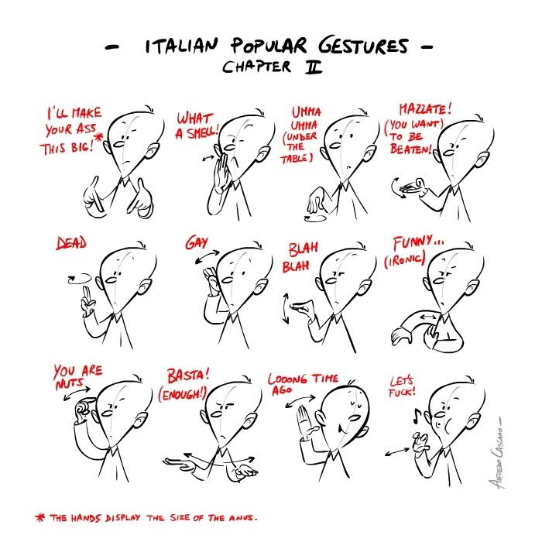

Slide 5
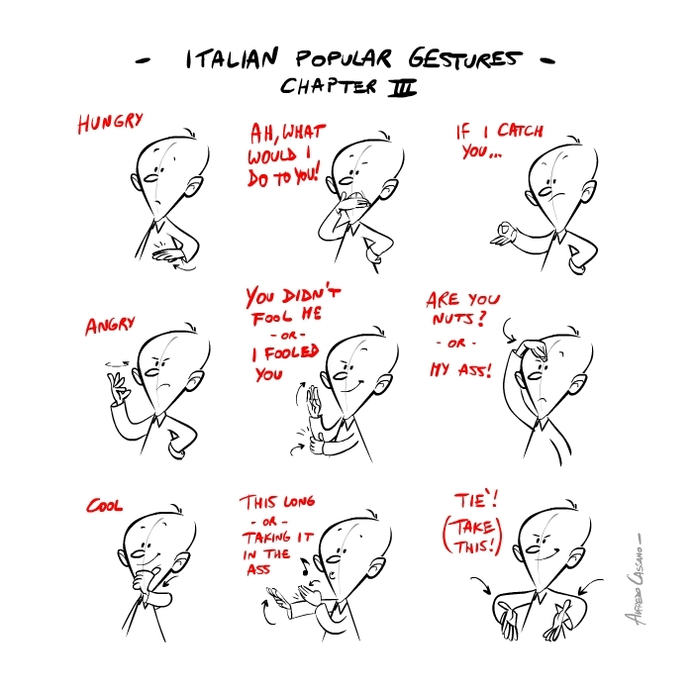

Slide 6
Getting to know each other
Please join us at PollEv.com/polimi2022

Slide 7
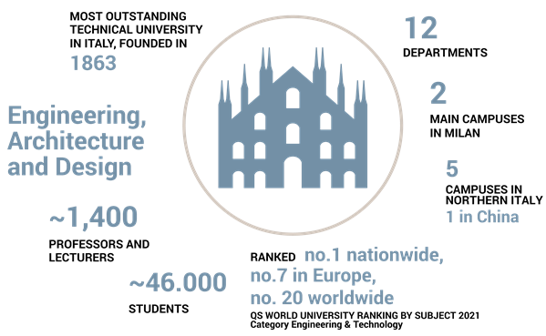
Politecnico di Milano

Slide 8
Politecnico di Milano
Research Departments
Aerospace Science and Technology
Architecture and Urban Studies
Architecture, Built Environment and Construction Engineering
Chemistry, Materials and Chemical Engineering “Giulio Natta”
Civil and Environmental Engineering
Design
Electronics, Information and Bioengineering
Energy
Management, Economics and Industrial Engineering
Mathematics “Francesco Brioschi”
Mechanical Engineering
Physics

Slide 9
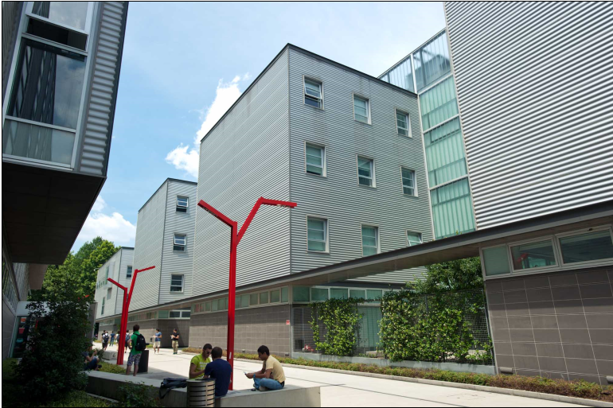
Politecnico di Milano School of Management

Slide 10
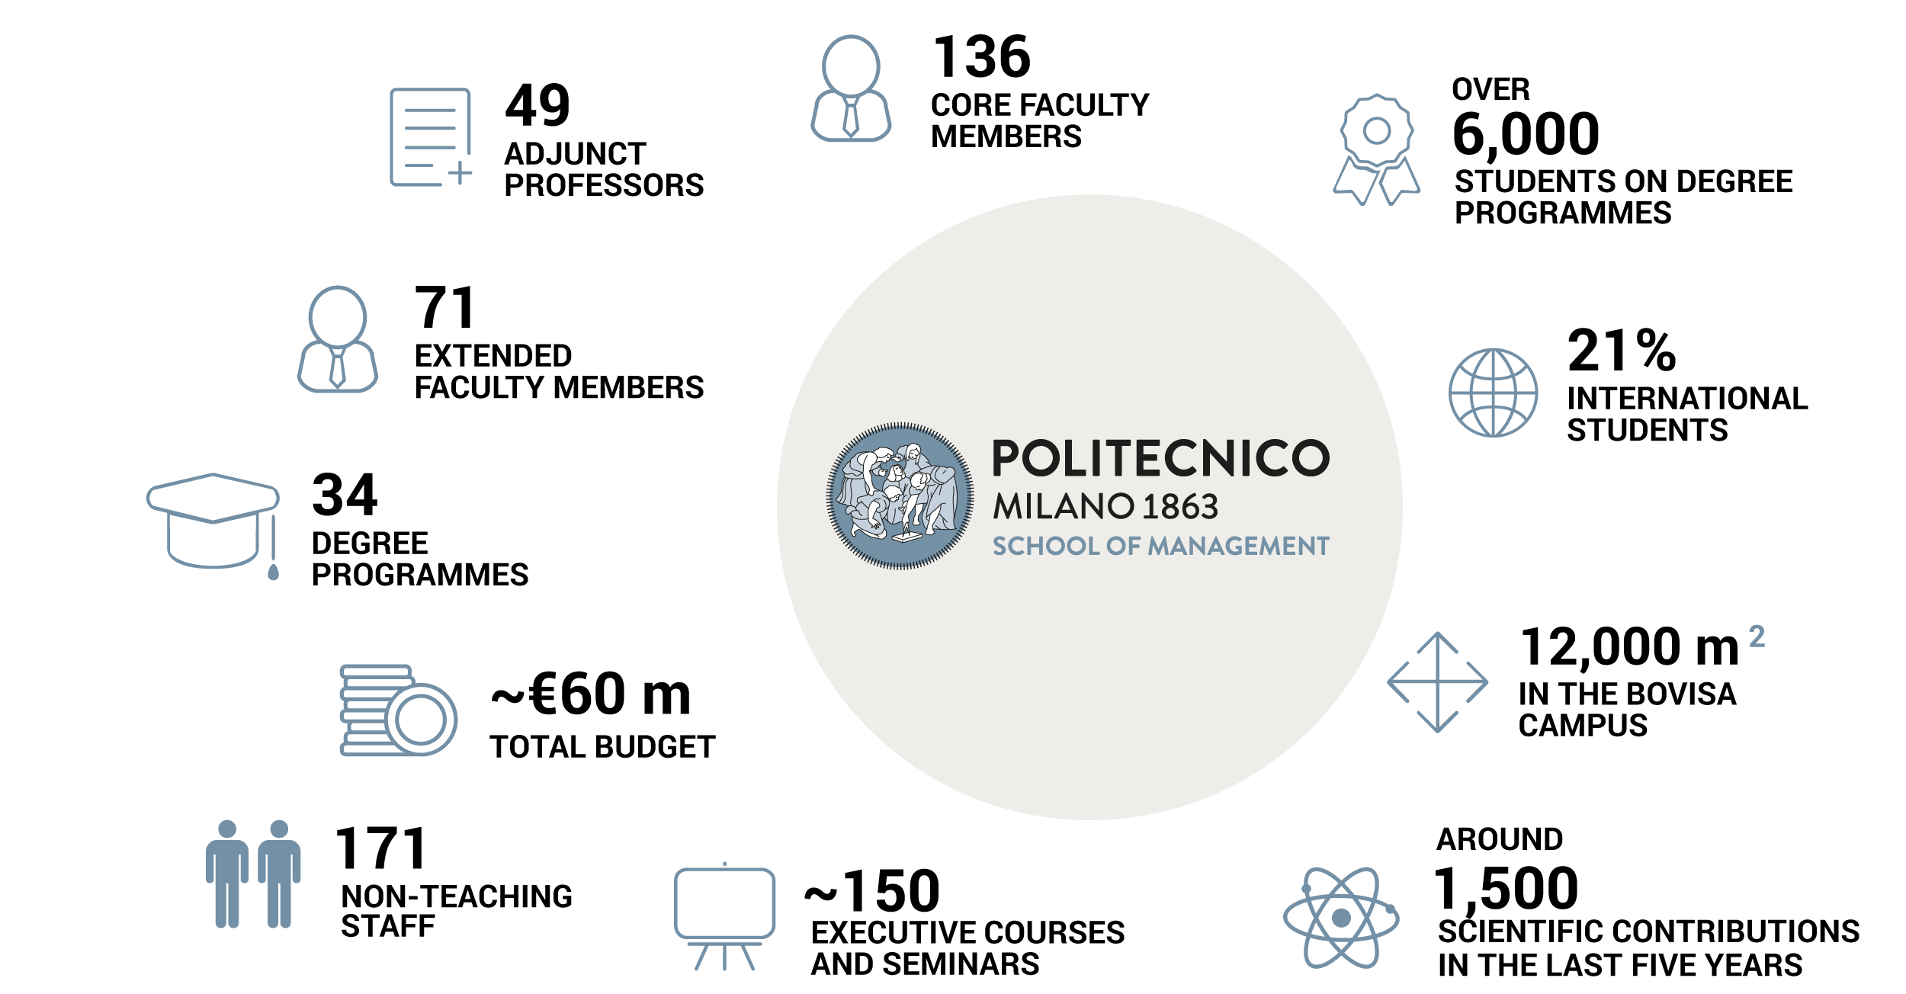
Politecnico di Milano School of Management

Slide 11

SoM Mission
Vision
We envision a world where responsible leaders are driven by the search for collective benefit empowered by technological enlightenment.
Mission
The mission of the School of Management (SoM) is to contribute to the collective good through a critical understanding of the opportunities offered by innovation.
HIGH‐QUALITY EDUCATION
HIGH‐QUALITY RESEARCH
ENGAGEMENT WITH THE COMMUNITY

Slide 12
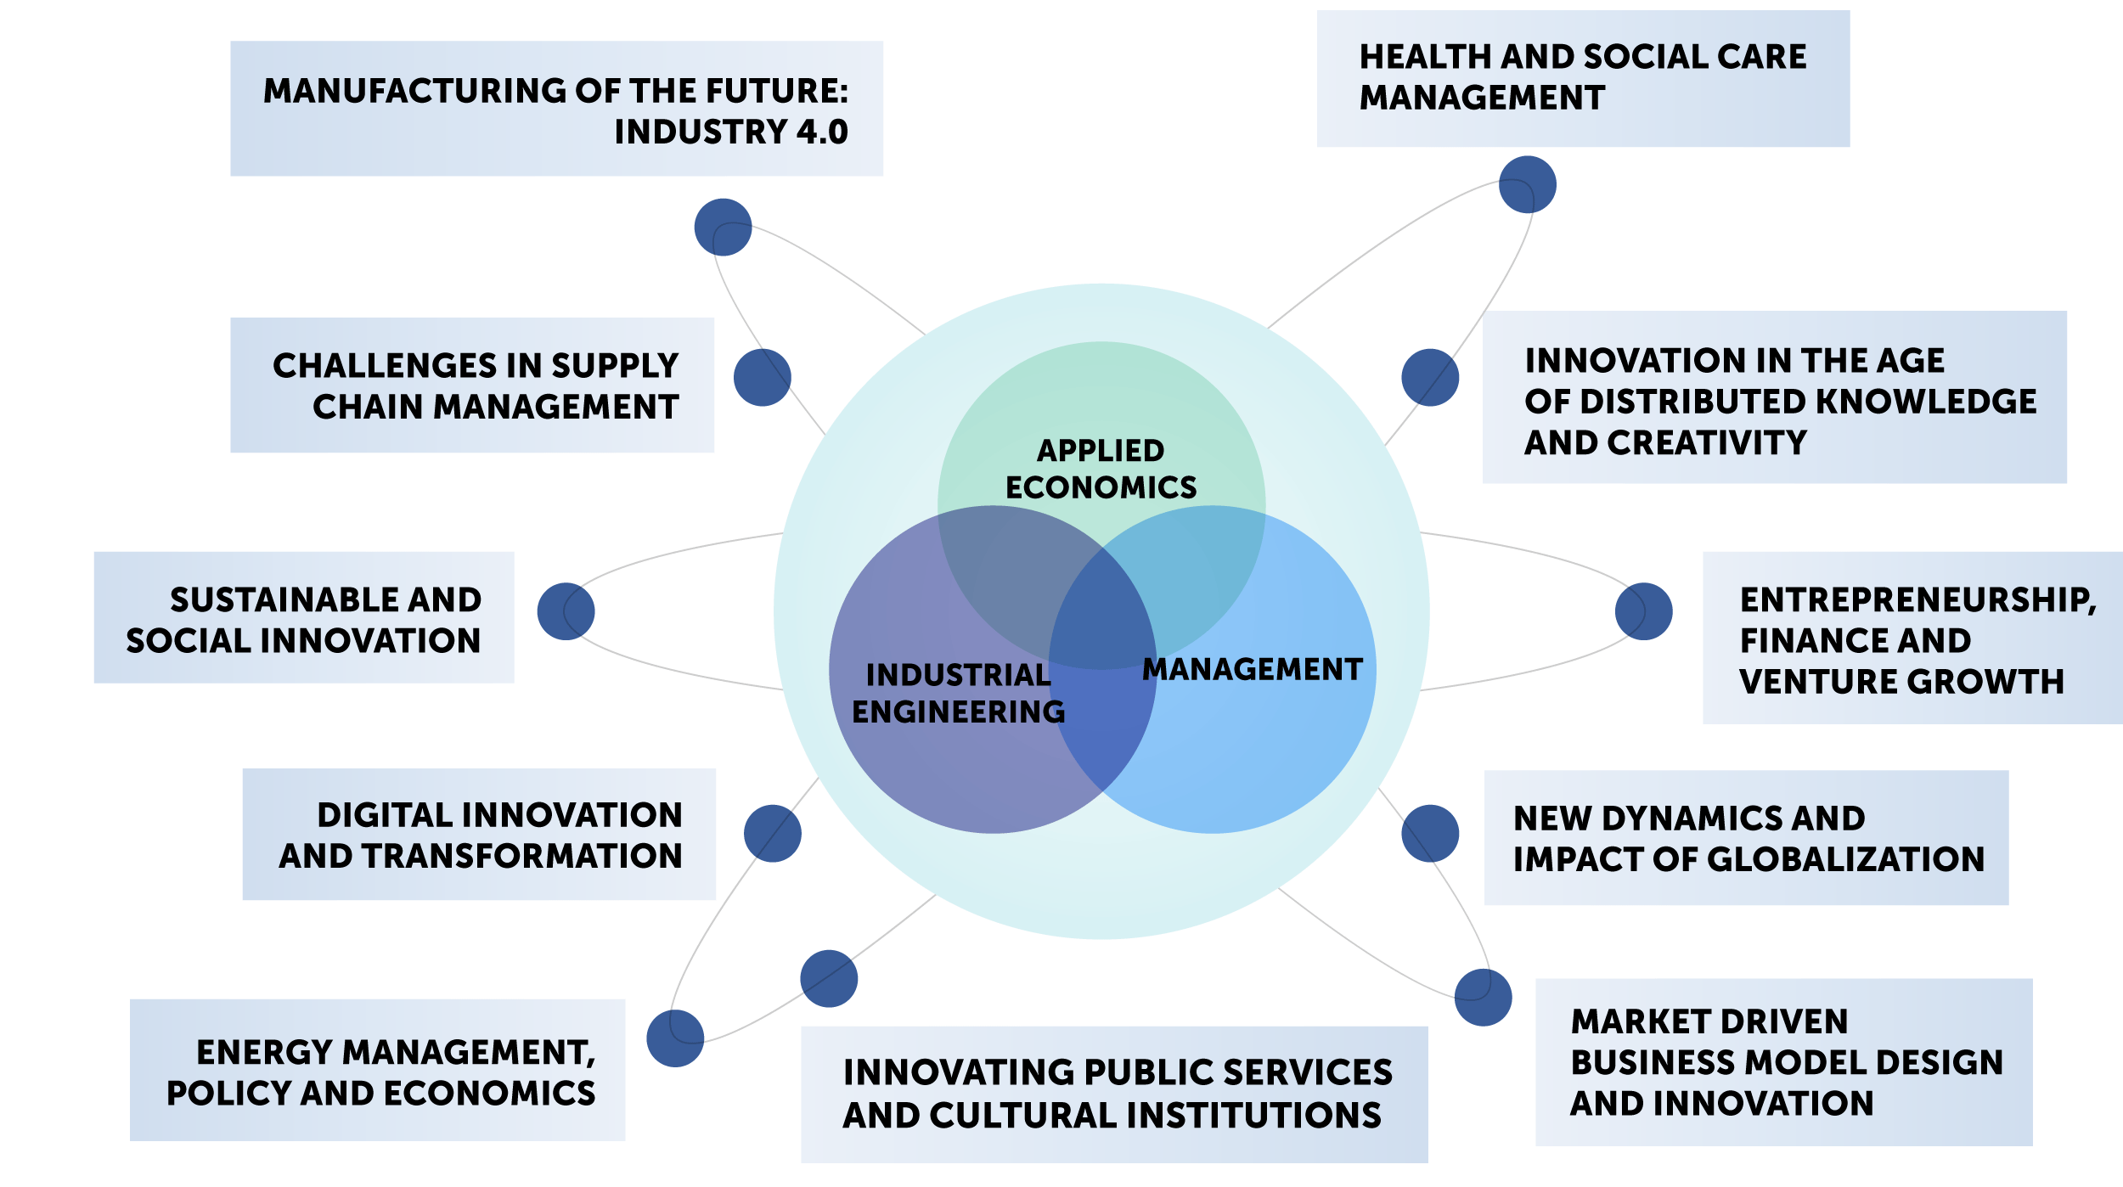
SoM Research Lines

Slide 13
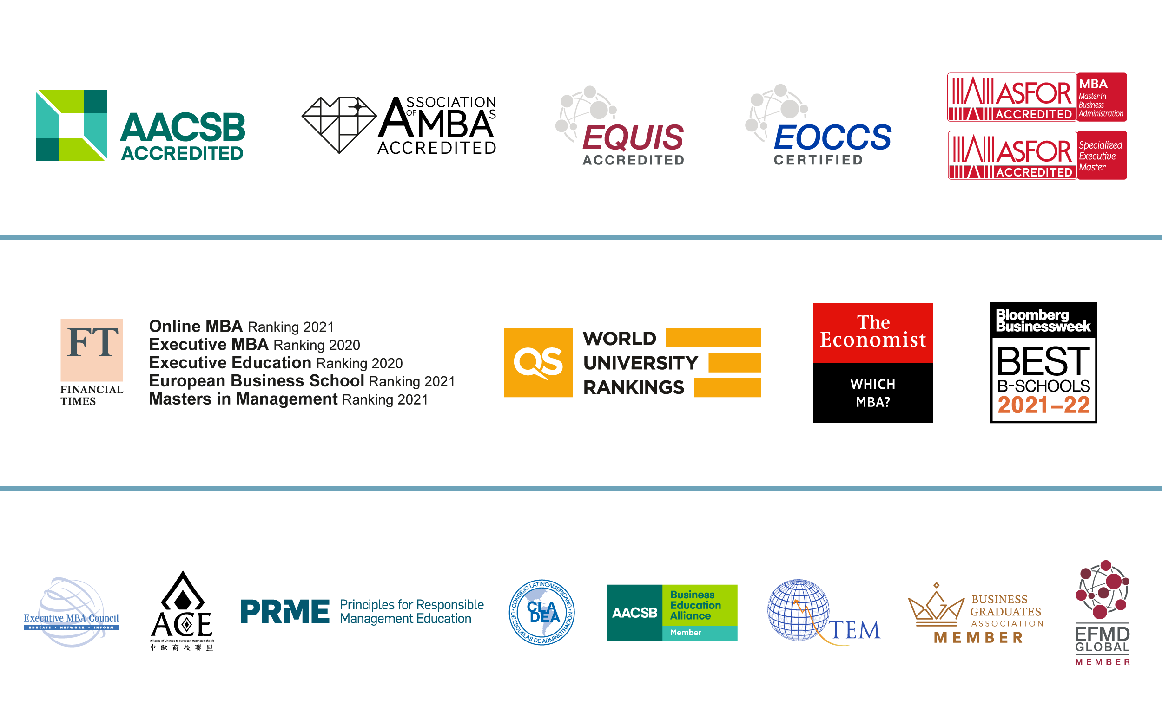
SoM Accreditations, Rankings & Memberships

Slide 14
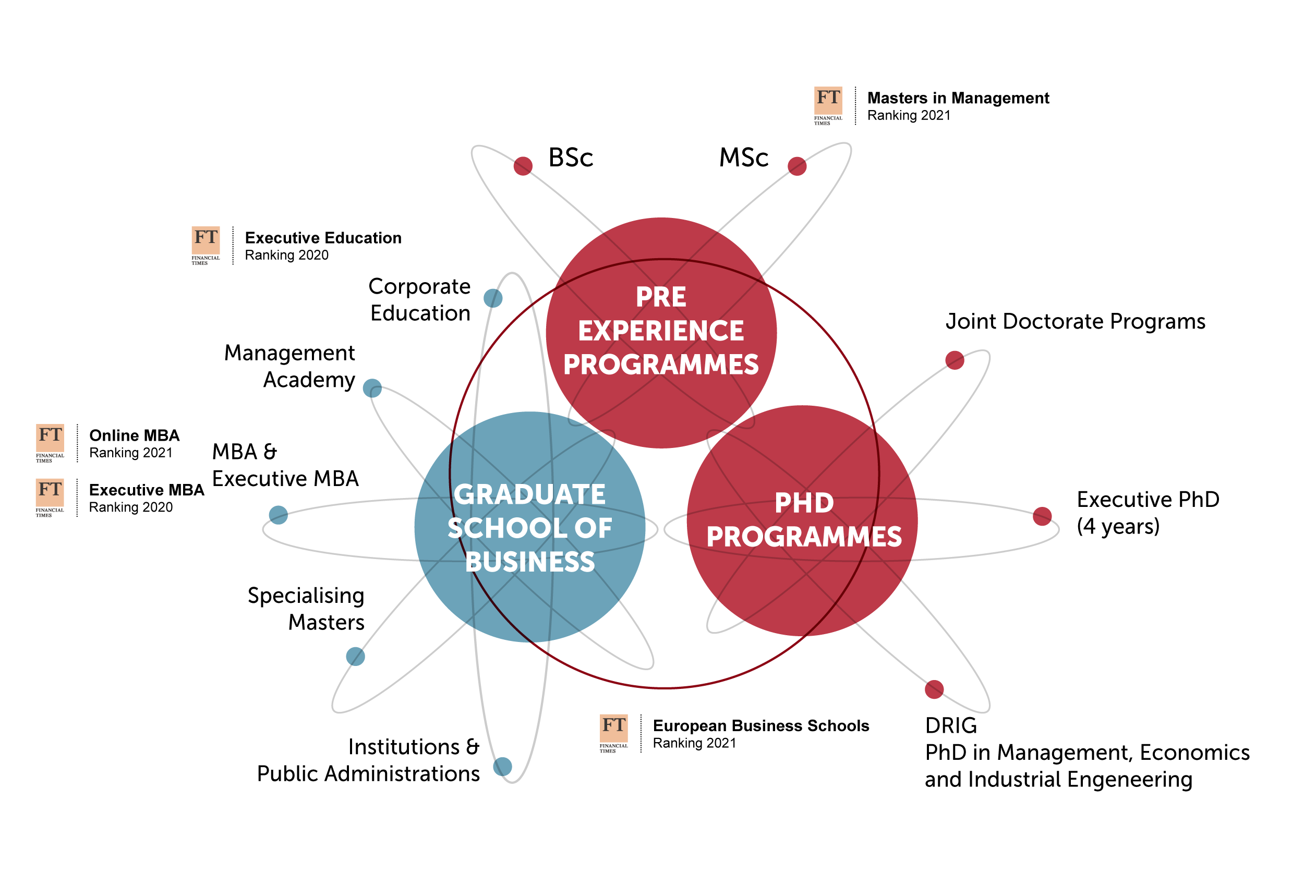
The SoM Programme Portfolio

Slide 15
Bachelor & Master of Science Degrees in Management Engineering
Our BSc and MSc degrees offer general and specific managerial competences based on a solid scientific and engineering background
3-year Bachelor of Science in Management Engineering (taught in Italian)
2-year MSc in Management Engineering (taught in English)
Every year +700 students enter the BSc programme and the MSc programme respectively; about 2.700 students overall
98% of placement within 1 year from graduation
Strong opportunities for experiences abroad through exchanges and double degree programmes

Slide 16
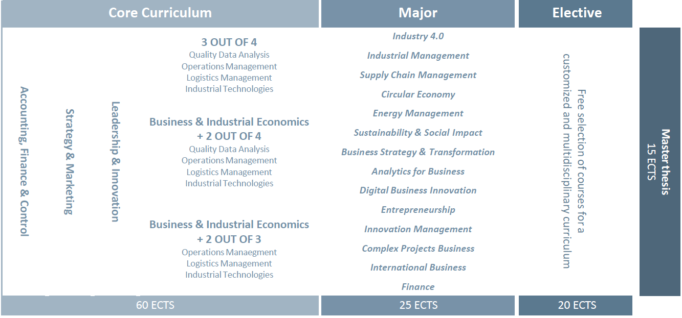
Master of Science in Management Engineering
Overall Structure
Two-year programme - 120 ECTS credits
The first year focuses on providing a common knowledge basis that characterizes the Master of Science programme
The second year is dedicated to developing vertical competencies within 14 Majors, focusing on different specialized disciplines
Some free choice courses are available to give students the possibility of receiving a multidisciplinary and customized education

Slide 17

International Exchanges at SoM
Incoming students:
> 1700 students in the last 6 years
From > 130 institutions
Outgoing students:
> 1380 students in the last 6 years
To > 140 institutions
Exchange Partnerships with 200 institutions (incoming + outgoing)

Slide 18
International Exchanges at SoM
Standard “Erasmus” exchanges
International Alliances
International Double/Dual Degrees
Normally 1 semester abroad (on average 30 ECTS credits)
More than 180 destinations worldwide
Both at BSc and MSc level
+250 outgoing students every year
Normally 1 year abroad (depending on the programs), possibly in more sites
Alliance4Tech
UNITECH
MSc level
1,5-2 years abroad
International Double Degrees promoted by POLIMI (40+ programs), at BSc and MSc level
International Dual Degrees promoted by SoM-POLIMI (Audencia, Solvay, Tongjii, Tsinghua), only MSc level

Slide 19




International Alliances at SoM

Slide 20
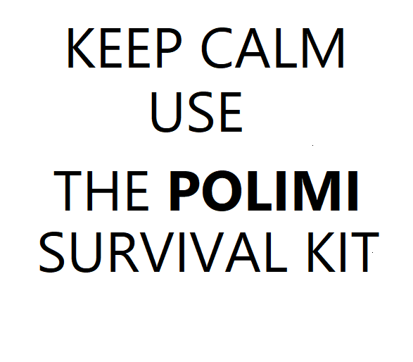

Welcome to Milano! What next?

Slide 21
What you should know…
  - About the Study Plan:
  Students must fill out their Study Plan online, based on their Learning Agreement and following the instructions and deadlines provided by the Studesk
  The Study Plan registration will activate almost everything:
      Exam registration
      Access to online materials provided by our Faculty (BeeP portal)
      Other online services
  The Study Plan can be changed every 6 months in the dedicated time-window (Sept/Oct- Feb/Mar)
  The Major can only be changed in September
  To know more, please follow this link: https://www.polimi.it/en/exchange-students-incoming/study-plan/
  Read carefully the Teaching Regulation and the programme structure: https://www.polimi.it/?id=6502&anno=2020&campus=&scuola=&corso=479&L=1

Slide 22
What you should know…
  – About the Course Registration and Structure:
    By submitting your Study Plan on line, you can register for classes
    Courses run by semester: Sept/Dec (exams in Jan/Feb); Feb/June (exams in June/July)
    Exchange students can enroll in most Polimi classes
    A full-time student enrols for approx. 30 ECTS credits
    Time-table is approx. 2 half-days per week
    Attendance is for the most part not mandatory, but it is better to inform the professor that you are there
    Most ME courses are open (no caps on courses)
    Students must pay attention to class location – 7 Campuses!

Slide 23
What you should know…
  – About Final Exams:
  Students cannot take exams for courses that are not included in their Study Plan
  It is up to you to choose when to take the exam (following the provided call calendar) but must be taken during regular exam calls (“Appello”)
  Exam Calls take place five times a year: January, July, September, December, April
  In order to take an exam, students must sign up for it in advance (online)
  You must provide an ID Card (with picture)
  Exams can be written, oral, or a mix. Some courses (e.g. labs) evaluate also assignments given throughout the semester.
  Exams are evaluated in “30” points (minimum passing grade 18)
  A student can refuse a grade and try the exam again, following the provided exam calendar (pay attention to professor’s instructions)
  Some courses might have a mid-term exam (Nov - May)

Slide 24
What you should know…
- About your final thesis:
Keep in mind that if you are studying at Polimi to pursue an international double degree, you will be required to end your program by discussing a final thesis, as all Polimi students
All students must have a Polimi supervisor. Check with your sending School’s requirements for type of thesis work (Polimi offers 3 options)
For a step-by-step guide of the process for international double degree students please refer to the SoM website here (STUDY WITH US > DOUBLE DEGREES TAB)

Slide 25
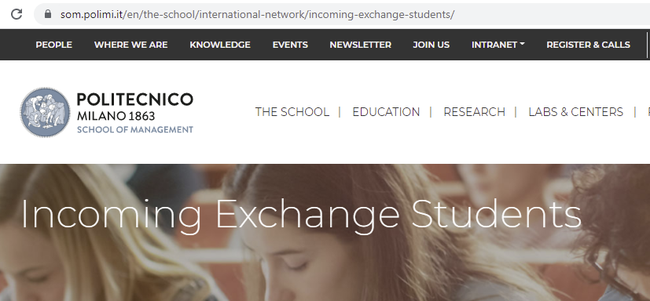
Where to find this presentation…
www.som.polimi.it/en > The School > International Network > Incoming Exchange Students >
USEFUL COURSE AND SCHEDULING INFORMATION FOR EXCHANGE STUDENTS

Slide 26
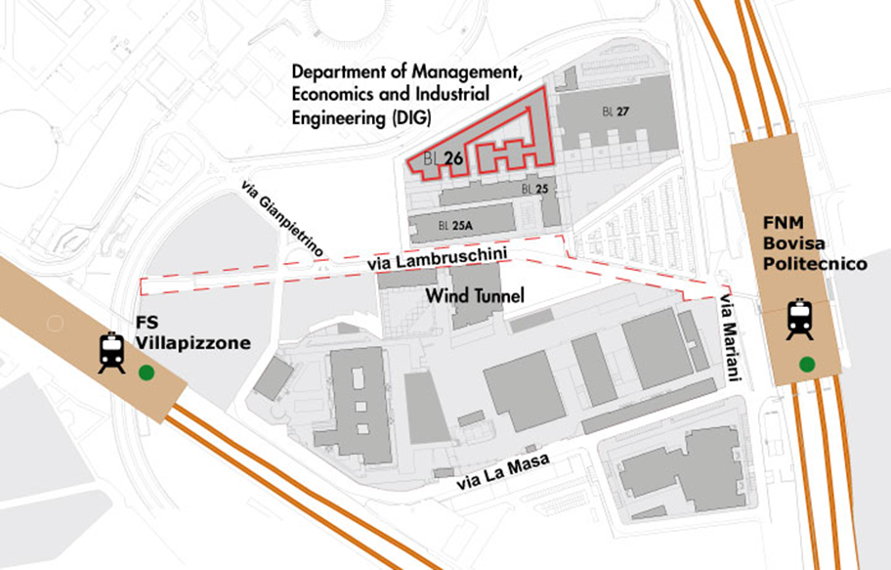


Where to find our Offices
Program Office & Intl. Relations Office: Via Lambruschini 4/b
Registrar’s Office & Studesk : Via Lambruschini 15

Slide 27

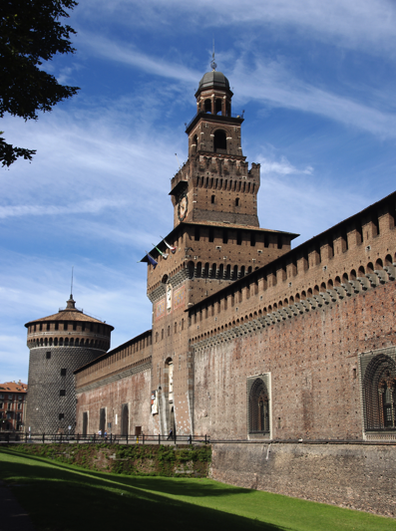


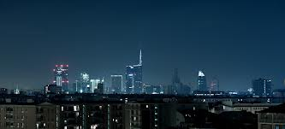

Milan l'è un gran Milan…

Slide 28
Learning Agreement to be signed?
Please send your Learning Agreement to:
exchangemanagement-dig@polimi.it
to the attention of Ms Diletta Fiasca;
Ms Fiasca will have them signed and return them to you

Slide 29
Useful Contacts
Diletta Fiasca
International Partnerships and Mobility Coordinator
exchangemanagement-dig@polimi.it
Office 0.03 - DIG Department
Anna Colella
International Partnerships and Mobility Manager
exchangemanagement-dig@polimi.it
Office 0.03 - DIG Department
Sergio Terzi
Academic Responsible for Exchange Mobilities for ME students
Coordinator of the ME International Double Degrees
sergio.terzi@polimi.it
Office 2.09 - DIG Department

